Slide 1


CSE 803 Introduction to Distributed Computing
m
Company
LOGO
1

Slide 2


DEFINITION
A distributed system is a collection of independent computers, interconnected via a network, capable of collaborating on a task.
A distributed system can be characterized as collection of multiple autonomous computers that communicate over a communication network and having following features:
⎫
⎫
No common Physical clock Enhanced Reliability
Increased performance/cost ratio
Access to geographically remote data and resources Scalability
⎫
⎫
⎫

Slide 3
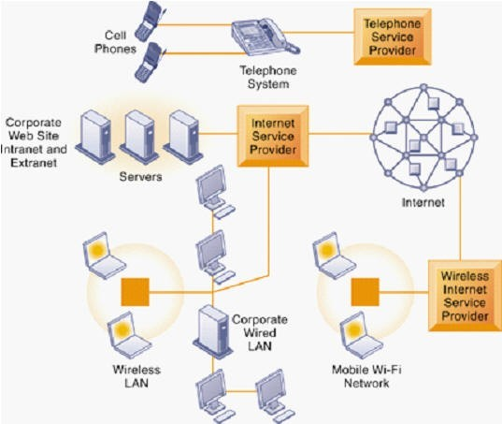
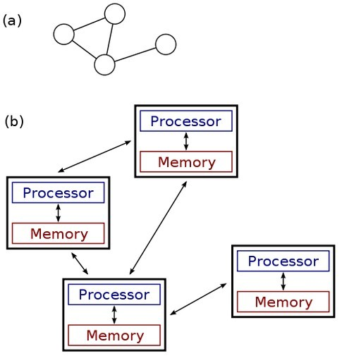
A Distributed System

Slide 4
Examples of Distributed System
Telephone Networks and Cellular Networks
Computer Networks Such as internet or intranet
ATM(bank) Machines
Distributed database and distributed database management system
Network of Workstations
Mobile Computing etc.

Slide 5
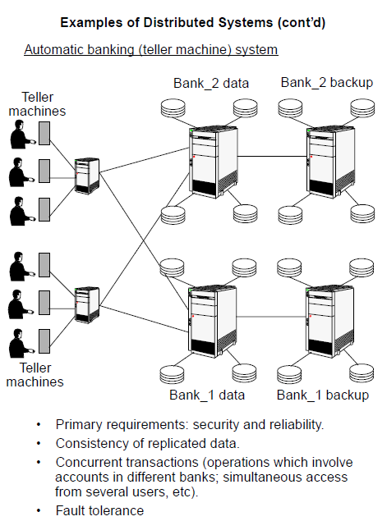

Slide 6
Advantages Of Distributed System
Information Sharing among Distributed Users
Resource Sharing
Extensibility and Incremental growth
Shorter Response Time and Higher Output
Higher Reliability
Better Flexibility’s in meeting User’s needs
Better price/performance ratio
Scalability
Transparency

Slide 7
Disadvantages of Distributed System
Difficulties of developing distributed software
Networking Problem
Security Problems
Performance
Openness
Reliability and Fault Tolerance

Slide 8
DEFINITION
♣
A system is said to be a Parallel System in which multiple processor have direct access to shared memory which forms a common address space.
Usually tightly-coupled system are referred to as Parallel System. In these systems, there is a single system wide primary memory (address space) that is shared by all the processors. On the other hand Distributed System are loosely-coupled system.
Parallel computing is the use of two or more processors (cores, computers) in combination to solve a single problem.
♣
♣

Slide 9
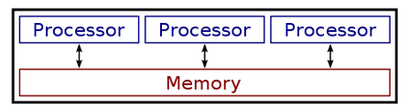
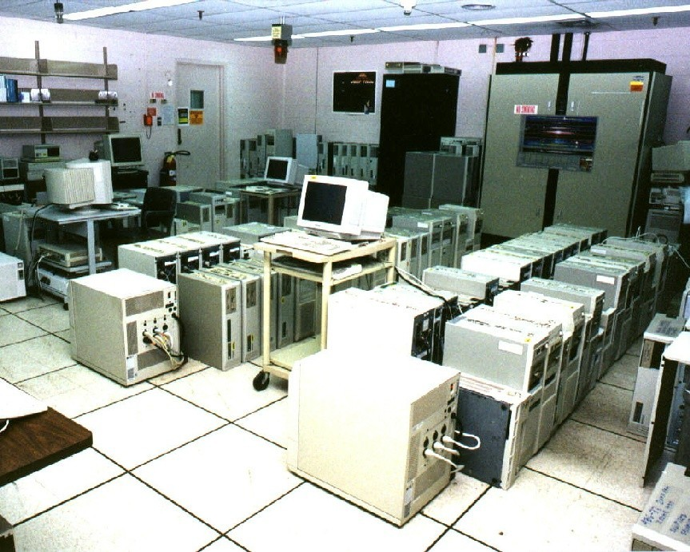
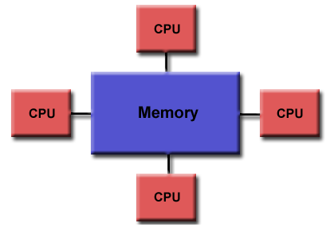
A Parallel System

Slide 10
Applications of Parallel System
An example of Parallel computing would be two servers that share the workload of routing mail, managing connections to an accounting system or database, solving a mathematical problem etc
Supercomputers are usually placed in parallel system architecture
Terminals connected to single server

Slide 11
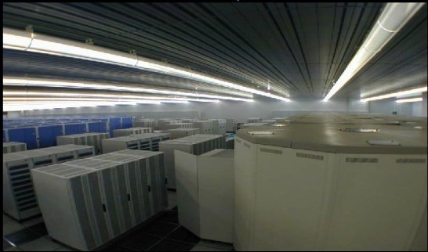
EXAMPLE: The Earth Simulator Supercomputer from (2002-2004)

Slide 12
Advantages of Parallel System
Provide Concurrency(do multiple things at the same time)
Taking advantage of non-local resources
Cost Savings
Overcoming memory constraints
Save time and money
Global address space provides a user-friendly programming perspective to memory

Slide 13
Disadvantages of Parallel System
Primary disadvantage is the lack of scalability between memory and CPUs.
Programmer responsibility for synchronization constructs that ensure "correct" access of global memory.
It becomes increasingly difficult and expensive to design and produce shared memory machines with ever increasing numbers of processors.

Slide 14
Parallel vs. Distributed System
Parallel Systems
Di stributed Systems
Memory
Tightly coupled system shared memory
Weakly coupled system Distributed memory
Control
Global clock control
No global clock control
Processor
interconnecti on
Order of Tbps
Order of Gbps
Mai n focus
Performance Scientific computing
Performance(cost and scalability) Reliability/availability Information/resource sharing
15

Slide 15
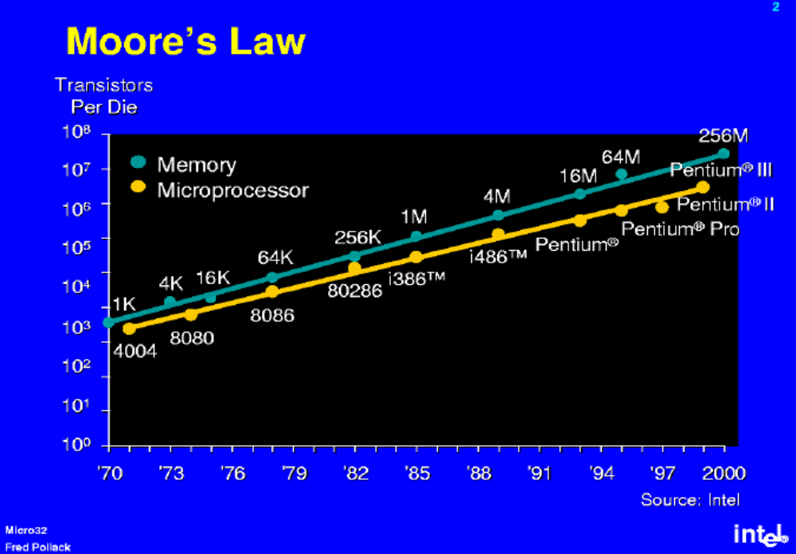
Why parallel and distributed computing?
Moore’s law: the number of transistors double every 18 months.

Slide 16
Why parallel and distributed computing?
How to make good use of the increasing number of transistors on a chip?
  Increase the computation width (70’s and 80’s)
    4bit->8bit->16bit->32bit->64bit->….
  Instruction level parallelism (90’s)
    Pipeline, LIW, etc
  ILP to the extreme (early 00’s)
    Out of order execution, 6-way issues, etc
  Sequential program performance keeps increasing.
    The clock rate keeps increasing, clock cycles get smaller and smaller.

Slide 17
Why parallel and distributed computing?
The fundament limit of the speed of a sequential processor.
  Power wall (high frequency results in heat)
  Latency wall (speed of light does not change)

Slide 18
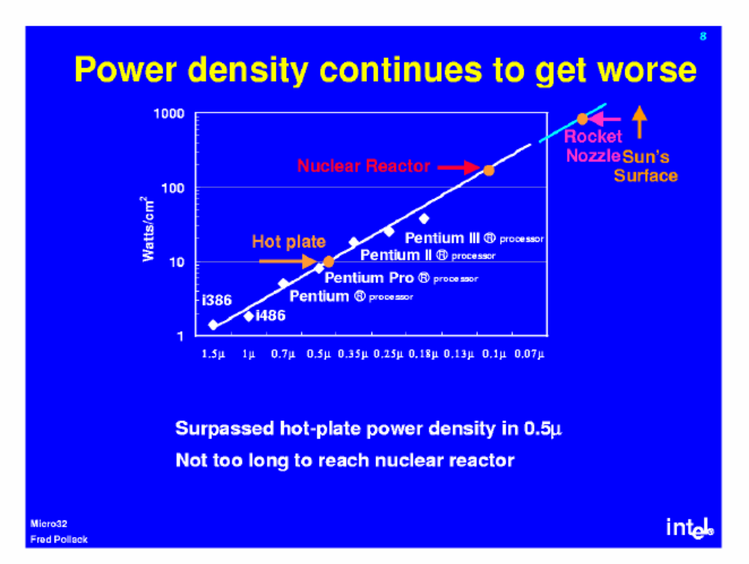
Power wall: what will happen if we keep pushing ILP?

Slide 19
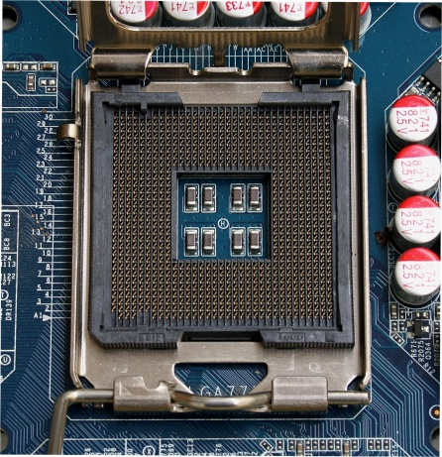
Latency wall
Speed of light = 300000000m/s
One cycle at 4Ghz = 0.00000000025s
The distance that the light can move at one cycle:
  0.00000000025 * 300000000 = 7.5cm
Intel chip dimension = 1.47 in x 1.47 in
= 3.73cm x 3.73cm

Slide 20
Why parallel and distributed computing?
Power wall and latency wall indicate that the era of single thread performance improvement through Moore’s law is ending/has ended.
More transistors on a chip are now applied to increase system throughput, the total number of instructions executed, but not latency, the time for a job to finish.
  Improving ILP improves both.
  We see a multi-core era

Slide 21
The marching of multi-core (2004-now)
  Mainstream processors:
    INTEL Quad-core Xeon (4 cores),
    AMD Quad-core Opteron (4 cores),
    SUN Niagara (8 cores),
    IBM Power6 (2 cores)
  Others
    Intel Tflops (80 cores)
    CISCO CSR-1 (180 cores) (network processors)
  Increase the throughput without increasing the clock rate.

Slide 22
Why parallel and distributed computing?
  Programming multi-core systems is fundamentally different from programming traditional computers.
    Parallelism needs to be explicitly expressed in the program.
  This is traditionally referred to as parallel computing.
    PDC is not really a choice anymore.

Slide 23
GO PARALLEL
Performance
1970
1980
1990
2000
2006

Slide 24
In the foreseeable future, parallel systems with multi-core processors are going mainstream.
  Lots of hardware, software, and human issues in mainstream parallel/distributed computing
    How to make use a large number of processors simultaneously
    How to write parallel programs easily and efficiently?
    What kind of software supports is needed?
    Analyzing and optimizing parallel programs is still a hard problem.
    How to debug concurrent program?

Slide 25
Parallel computing issues
Data sharing – single versus multiple address space.
Process coordination – synchronization using locks, messages, and other means.
Distributed versus centralized memory.
Connectivity – single shared bus versus network with many different topologies.
Fault tolerance/reliability.

Slide 26
Distributed systems issues
Transparency
  Access (data representation), location, migration, relocation, replication, concurrency, failure, persistence
Scalability
  Size, geographically
Reliability/fault tolerance

